Slide 1
Automated Detection
Of Skin Cancer from Dermoscopy Image
GROUP ID: 25HR10
Priyanshi Agrawal: 2301CS90
Shiksha Raginee: 2301AI13
Preeti Kumari: 2301AI17
CH.Rincy Chelciya 2301CS40

Slide 2
Member Name | Roll No. | Role | Key Responsibilities
Priyanshi Agrawal | 2301CS90 | Project Lead | Coordinated project timeline; ensured consistency across all notebooks; supervised preprocessing pipeline; managed lesion-level splitting and dataset integrity verification; final QA and integration of all model outputs.
Shiksha Raginee | 2301AI13 | Data source Lead | Handled dataset reconstruction from Part 1 and Part 2 folders; removed duplicates; validated metadata; implemented oversampling strategies; organized train/val/test CSVs
Preeti Kumari | 2301AI17 | Modeling Lead | Implemented all model architectures: Binary CNN, 7-Class CNN, VGG16 transfer learning, ResNet50 fine-tuning, and SVM using VGG16 features; conducted hyperparameter tuning and training in separate notebook
CH.Rincy Chelciya | 2301CS40 | Documentation Lead | Prepared report structure; designed methodology diagrams; wrote algorithms ; consolidated literature review; documented system architecture and prepared slide deck.

Slide 3
Introduction:
Problem Statement :
Skin cancer is one of the most common and deadly forms of cancer worldwide.
Dermatologists use dermoscopic images to examine suspicious skin lesions, but Early-stage melanoma often resembles benign lesions
Manual diagnosis is subjective and depends on specialist expertise
Healthcare systems lack sufficient dermatologists, especially in rural areas
Misclassification can delay treatment and increase mortality
Therefore: There is a need for an automated, reliable, and scalable system that can assist clinicians by classifying skin lesions accurately.

Slide 4
Motivation :
Early detection can increase melanoma survival rates up to 97%
Deep learning has shown strong performance in image-based medical tasks
Public datasets like HAM10000 allow reproducible research
Automated systems can support dermatologists and reduce diagnostic workload
Our project aligns with modern healthcare goals:
AI-assisted diagnosis, speed, affordability, and accessibility
Objectives :
Our project aims to:
Develop a deep learning–based system to classify dermoscopic images from the HAM10000 dataset.

Slide 5
Reconstruct the dataset by:
~ Removing duplicate images from Part 1 and Part 2
~ Performing lesion-level (patient-aware) splitting
~ Balancing classes through oversampling
Train and evaluate multiple models.
~ Custom CNN models
~ Binary CNN (Benign vs. Malignant)
~ 7-Class CNN (Full classification)
~ Transfer Learning Models
~ VGG16 (fine-tuned)
~ ResNet50 (fine-tuned)
~ Hybrid Deep Learning + ML Model
~ VGG16 Feature Extraction + Linear SVM
Compare models based on:
~ Accuracy
~ Precision, Recall, F1-score
~ Confusion matrix analysis
~ Build an inference module to classify any user-uploaded dermoscopic image.

Slide 6
Literature:
Author | Title | Description
Mridha et al. (2023) | “Interpretable Skin Cancer Classification Using Optimized CNN” — IEEE Access | ✔ Used an optimized CNN for classifying dermoscopy images ✔ Reported 93.4% accuracy on their dataset ✔ Employed class balancing and augmentation — same as our pipeline ✔ Supports our Custom CNN and Binary CNN development ✔ Their focus on interpretability aligns with our future work section
Mahmud et al. (2023) | “An Interpretable Deep Learning Approach for Skin Cancer Categorization” — arXiv | ✔ Proposed a deep learning model for multi-class lesion classification ✔ Achieved 91–94% accuracy depending on lesion type ✔ Their model supports our 7-Class CNN, VGG16, and ResNet50 approach ✔ Emphasized explainable AI (XAI), consistent with our project’s motivation
Murali & Mazumder (2025) | “Skin Cancer Detection Using Deep Learning Techniques: A Review” — Research Square (Preprint) | ✔ Reviewed modern deep learning models including VGG16, ResNet, Inception ✔ Noted that transfer learning models achieve 75–90% accuracy on HAM-like datasets ✔ Confirms our use of VGG16 Transfer Learning and ResNet50 Fine-Tuning ✔ Highlighted challenges: class imbalance & inter-class similarity — same issues we solved
Naqvi et al. (2023) | “Skin Cancer Detection Using Deep Learning — A Review” — Diagnostics Journal | ✔ Surveyed CNN-based and transfer-learning methods ✔ Showed that hybrid models (Deep Features + ML classifiers) reach 80–92% accuracy ✔ Directly supports our VGG16 Feature Extraction + SVM experiment ✔ Also mentions the role of augmentation and preprocessing, matching our methodology
IJIT Journal (2023) | “Deep Learning-Based Skin Cancer Detection” — IJIT, Vol. 4, Issue 2 | ✔ Discussed use of CNNs and transfer-learning on dermoscopy datasets ✔ Reported accuracies in the range of 70–88% using pretrained models ✔ Helps justify why deep CNNs outperform simple models ✔ Supports our finding that ResNet50 and VGG16 perform better than scratch CNN

Slide 7
Methodology :
Purpose: prepare clean image folder and create train/val/test CSV splits ` (lesion-level, no leakage).
Main steps:
~ fix dataset paths, unzip
~ copy images from Part1 & Part2 into one folder while skipping duplicate filenames
~ load metadata CSV and attach filepath to each row
~ Label-encode the 7 classes (dx → label)
~ do lesion-level split → train / val / test
~ oversample training set only (row-level) to balance classes
~ save df_train.csv, df_val.csv, df_test.csv to split Outputs: balanced df_train.csv, df_val.csv, df_test.csv and image folder.
Notebook 1 — Preprocessing_and_splits (N1)
Purpose: train a custom CNN to classify Benign vs Malignant (binary).
Main steps:
~ load splits CSVs from N1 and create binary labels (benign / malignant)
~ make ImageDataGenerators with augmentation (rescale + flips + shifts + zoom)
~ build small 3-block CNN (Conv32 → Conv64 → Conv128 → Dense(128) → Dense(2))
~ compile with Adam,
~ train
~ evaluate on test set, produce confusion matrix and classification report
~ save binary_cnn_best.h5
Outputs: binary_cnn_best.h5, plots, classification report
Notebook 2 — Binary CNN (N2)
Purpose: train a 7-class CNN
Main steps:
~ load balanced df_train.csv, df_val.csv, df_test.csv
~ ImageDataGenerators (rescale + augmentation) with class_mode='categorical’
~ build 7-class CNN (same 3 conv blocks but Dense(256) before output)
~ training (longer epochs than binary)
~ evaluate (accuracy, classification report, confusion matrix)
~ save cnn7_best.h5
Outputs: cnn7_best.h5, metrics, confusion matrix.
Notebook 3 — 7-Class CNN (from scratch) (N3)

Slide 8
Methodology :
Purpose: use VGG16 (ImageNet) as backbone, train a 7-class classifier.
Main steps:
~ Loads splits from N1 and uses VGG preprocessing function
~ data generators with VGG preprocessing + augmentation for train
~ build model: VGG16 → freeze most layers → Dense(256) → Dropout → Dense(7)
~ compile, train head first
~ evaluate on test set (classification report + confusion matrix)
~ save vgg16_best.h5
Outputs: vgg16_best.h5, metrics
Notebook 4 — VGG16 Transfer Learning (7-class) (N4)
Purpose: ResNet50 for 7-class classification
Main steps:
~ load splits and use ResNet preprocess function
~ data generators (train with augmentation)
~ ResNet50 → unfreeze last ~50 layers → Dense(256) → Dropout → Dense(7)
~ compile, train
~ evaluate on test set and show confusion matrix + report
~ save resnet50_best.h5
Outputs: resnet50_best.h5, test metrics (77.53% accuracy), confusion matrix.
Notebook 5 — ResNet50 (7-class) (N5)
Purpose: extract VGG16 global-average features and train a linear SVM on them.
Main steps:
~ load splits and build ImageDataGenerator with VGG preprocessing (no augmentation)
~ create feat_model = VGG16
~ extract features for train / val / test (one pass)
~ build a pipeline: StandardScaler → LinearSVM and train on features
~ evaluate on validation and test (accuracy, report, confusion matrix)
~ save SVM model
~ inference helper: preprocess → extract feature → SVM predict
Outputs: svm_vgg_features.joblib, classification report.
Notebook 6 — VGG16 Features + Linear SVM (N6)

Slide 9
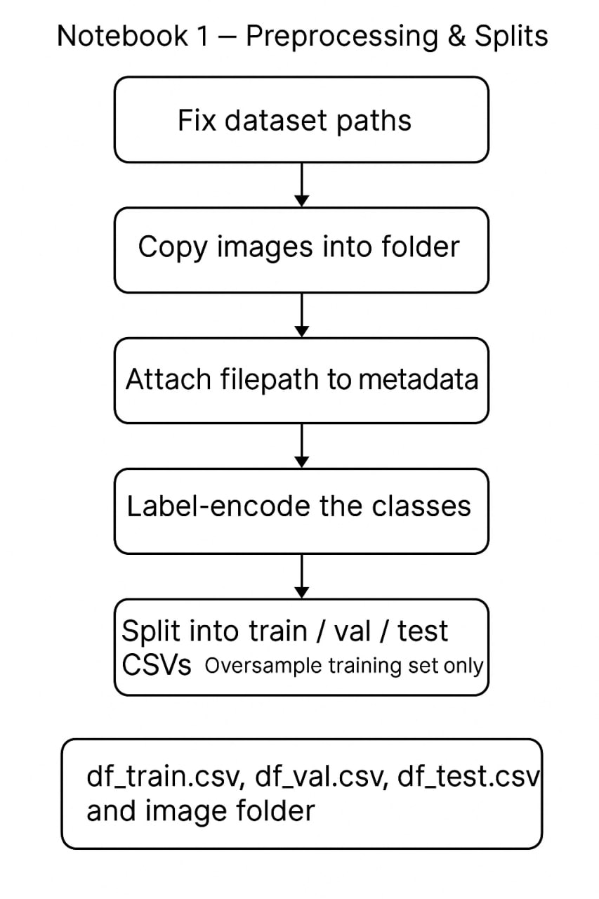
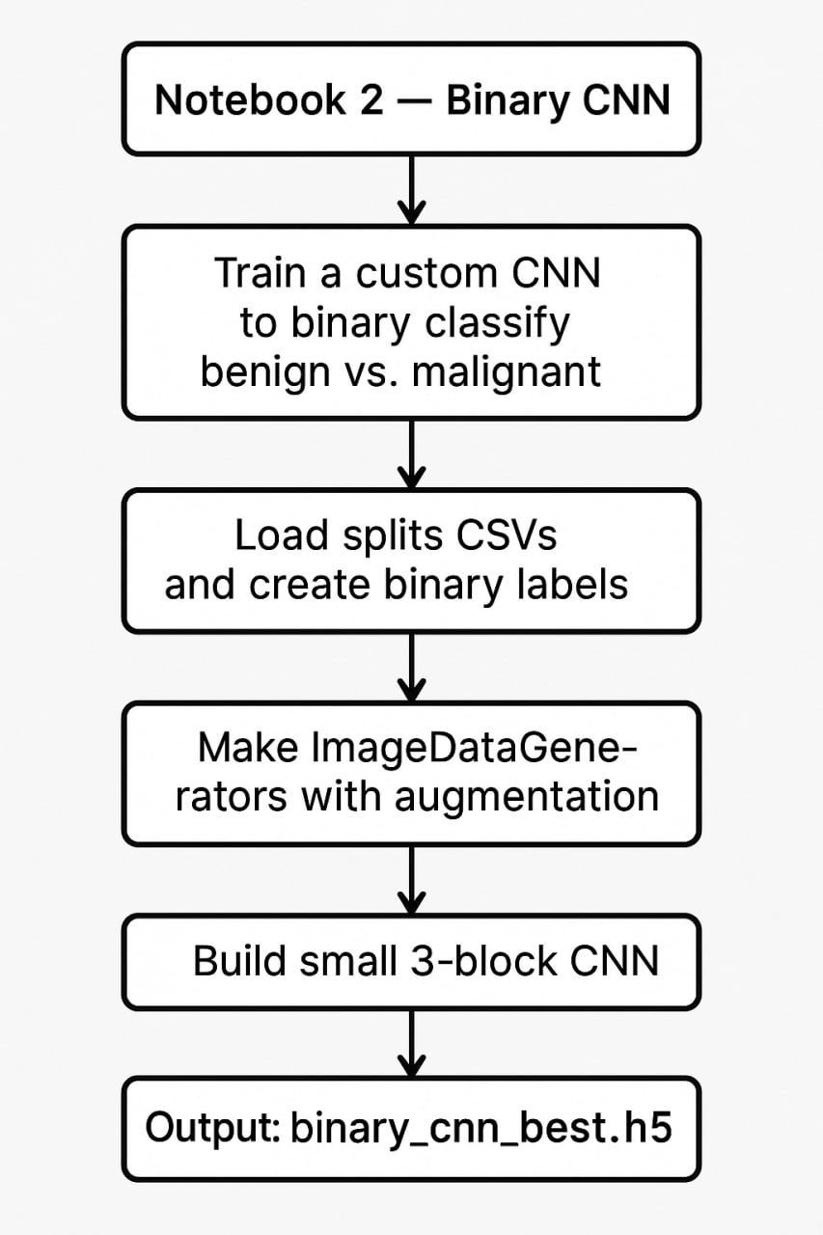
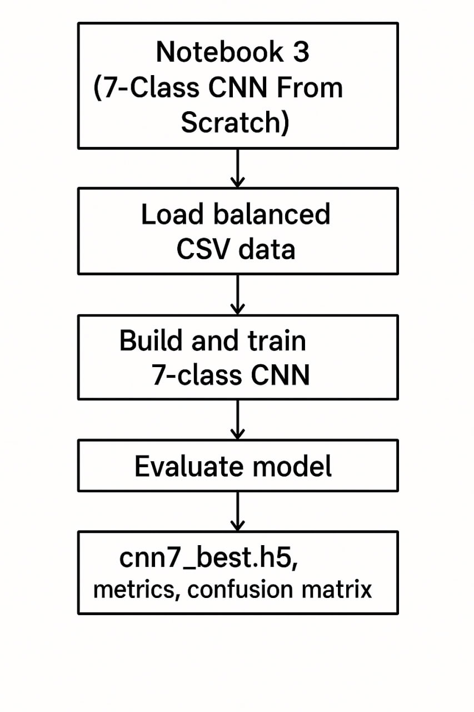
FLOWCHARTS
Binary CNN (N2)
Preprocessing and_Splits (N1)
7-Class CNN (from scratch) (N3)

Slide 10
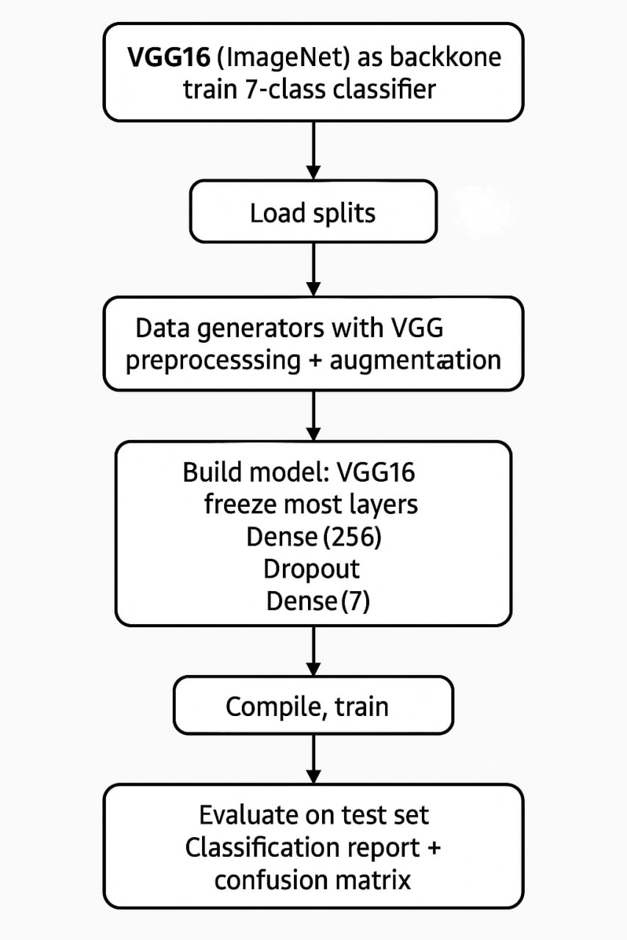
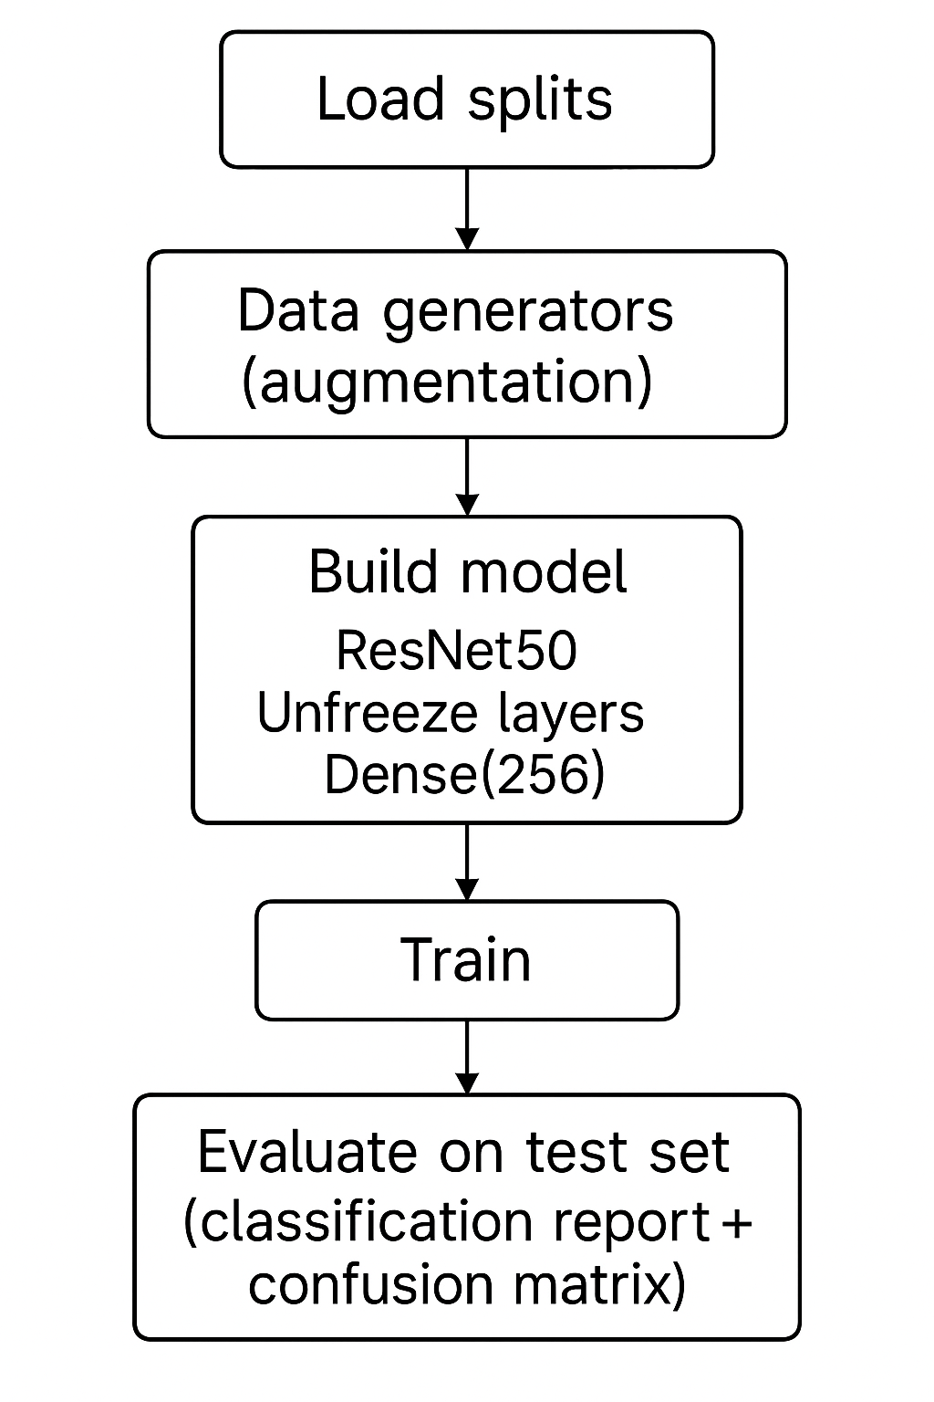
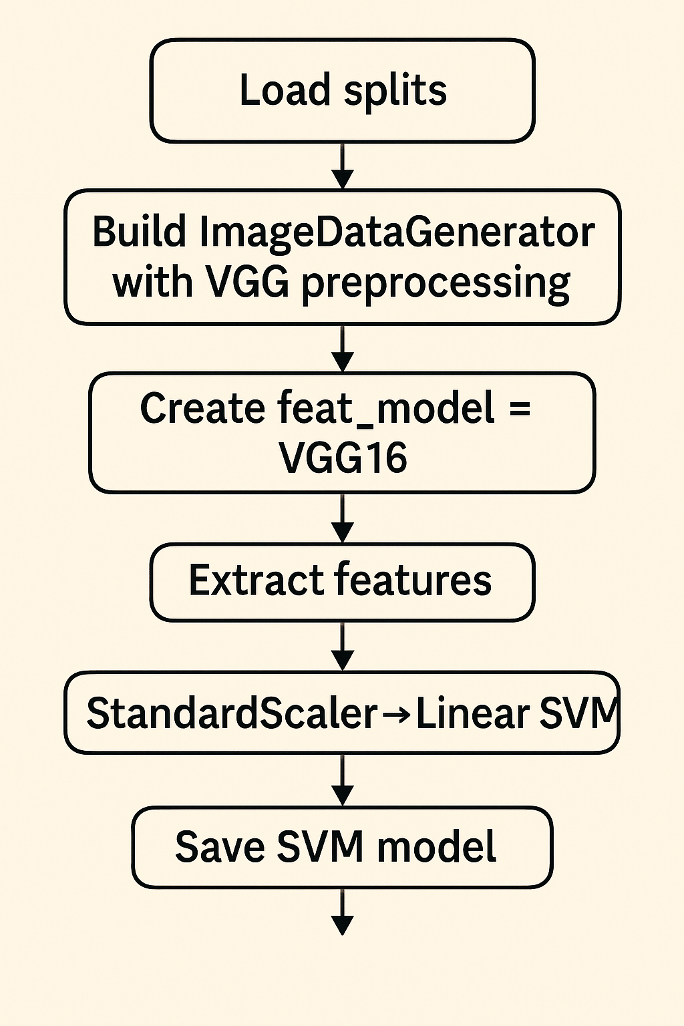
FLOWCHARTS
ResNet50 (7-class) (N5)
VGG16 Features + Linear SVM (N6)
VGG16 Transfer Learning (7-class) (N4)

Slide 11
Results and Discussion :
Results Overview
We evaluated five models on the HAM10000 dataset.
To measure clinical usefulness, we used:
~ Accuracy — overall correctness
Macro Recall — important in medical diagnosis (measures how many actual diseased cases were detected)
Macro F1-Score — balances precision and recall

Slide 12
Results and Discussion :
Model Name | Performance | Why these results? | Summary
7-Class CNN (Baseline Model) | Accuracy: 64.55% Macro Recall: 0.49 Macro F1: 0.48 | No pretrained knowledge → the model had to learn all features from zero Dermoscopy images have very fine texture patterns, which shallow CNNs cannot learn well Not deep enough → lacks capacity to capture small pigment networks, streaks, and color variations Oversampling helped, but since the model is simple, it could not fully learn minority classes High inter-class similarity (mel vs bkl, bcc vs bkl) confused a simple architecture | It builds a basic understanding of the dataset but cannot learn the deeper patterns seen in medical images.
VGG16 Transfer Learning | Accuracy: 72.64% Macro Recall: 0.63 Macro F1: 0.61 | Pretrained on ImageNet → already knows how to detect edges, curves, colors, and textures Fine-tuning allowed adaptation → last layers learned lesion-specific features Deeper architecture → more filters = better texture representation Generalizes well because pretrained filters prevent overfitting | Learns richer features than scratch CNN because it starts with strong pretrained knowledge..
Binary CNN (Benign vs Malignant) | Accuracy: 81.01% Macro Recall: 0.69 Macro F1: 0.70 | Binary classification is simpler than 7-class classification Only needs to separate “benign-looking” vs “malignant-looking” patterns Balanced oversampling significantly improved malignant detection Less class overlap → easier decision boundary | Binary decision-making reduces complexity, boosting accuracy.
ResNet50 | Accuracy: 77.53% Macro Recall: 0.57 Macro F1: 0.60 | Much deeper network → learns both global structures & fine-level lesion textures Residual connections prevent vanishing gradients, so deeper layers train properly Handles complex lesion patterns like pigment streaks, irregular borders, and multi-color lesions Better separation between visually similar classes | ResNet sees small details that VGG16 and CNN miss, making it the strongest 7-class model.
VGG16 + Linear SVM | Accuracy: 61.69% Macro Recall: 0.45 Macro F1: 0.41 | VGG16 kept fully frozen → features not adapted to medical images Linear SVM cannot handle nonlinear lesion patterns No fine-tuning means no learning of dermoscopic-specific features Works well only for highly distinct classes (e.g., nevus) but fails on similar ones | Deep features are strong, but without fine-tuning + nonlinear classifier, performance drops.

Slide 13
Final Model Comparison Table
Model | Accuracy % | Macro Recall | Marco F1 | Notes
7-Class CNN (Baseline Model) | 64.55 | 0.49 | 0.48 | Good baseline
VGG16 TL (7-class) | 72.64 | 0.63 | 0.61 | Strong generalization
Binary CNN | 81.01 | 0.69 | 0.70 | Best for binary tasks
ResNet50 (7-class) | 77.53 | 0.57 | 0.60 | Best multi-class performance
VGG16 + SVM (7-class) | 61.69 | 0.45 | 0.41 | Limited by linear classifier
Key Insights:
Why do the models perform differently?
Scratch CNN: Too shallow → cannot learn fine dermoscopic textures → lower accuracy
VGG16 TL: Pretrained filters + fine-tuning → learns shapes, colors, and edges better → strong improvement
Binary CNN: Easier 2-class problem → clearer boundaries → highest accuracy in binary task
ResNet50 TL: Deep layers + residual blocks → captures complex lesion patterns → best 7-class performance
VGG16+SVM: Features frozen + linear classifier → cannot learn nonlinear patterns → lowest multi-class accuracy

Slide 14
Conclusion :
~ This project built and tested several deep-learning and hybrid models for classifying skin-lesion images from the HAM10000 dataset.
~ Among all models, ResNet50 gave the best accuracy for 7-class classification (77.53%), and the Binary CNN performed well for benign vs malignant classification (81.01%).
~ This shows that pretrained models are more effective than training a CNN from scratch.
~ Although the results are good, some skin-lesion classes are still difficult to separate because many of them look very similar.
Future improvement can be done by:
~ using stronger data-augmentation methods,
~ trying more advanced pretrained models,
~ adding more balanced data for the rare classes, and combining predictions from multiple models.
Overall, this work provides a solid starting point for building an automated system that can help in early skin-cancer detection.

Slide 15
Contributions and novelties :
Clean and Reliable Dataset Reconstruction. Removed duplicate images from Part 1 and Part 2 Corrected metadata issues and ensured consistent labels Used lesion-level splitting (GroupShuffleSplit) to eliminate patient-level leakage Ensures fair training and realistic evaluation | Comprehensive Model Benchmarking Implemented and compared five major architectures on the same dataset: Custom CNN (Binary + 7-class) VGG16 (Transfer Learning) ResNet50 (Fine-tuning) VGG16 + SVM (Deep Features + Classical ML) Evaluated with accuracy, precision, recall, and F1-score Provides a complete understanding of which model suits dermoscopy classification best | Balanced Framework for Medical Image Classification Applied oversampling to handle severe class imbalance Ensured reproducibility with saved CSV splits and separate notebooks Built end-to-end workflow: preprocessing → model training → evaluation Creates a practical and reusable pipeline for future skin-cancer AI research

Slide 16
References :
Mridha, K. et al. (2023)
“Interpretable Skin Cancer Classification Using Optimized CNN,”
IEEE Access, 2023.
Mahmud, F. et al. (2023)
“An Interpretable Deep Learning Approach for Skin Cancer Categorization,”
arXiv preprint, 2023.
Murali, P. & Mazumder, D. H. (2025)
“Skin Cancer Detection Using Deep Learning Techniques: A Review,”
Research Square, 2025.
Naqvi, M. et al. (2023)
“Skin Cancer Detection Using Deep Learning — A Review,”
Diagnostics, 2023.
IJIT Journal (2023)
“Deep Learning-Based Skin Cancer Detection,”
International Journal of Information Technology, Vol. 4, Issue 2, 2023.

